Slide 1
Technical and functional analysis of TOMP-API Mars 2023

Slide 2
Outline
Objectives and methods
Presentation of TOMP-API
System architecture
Links with GBFS
Links with GTFS
Positioning towards OJP
Positioning towards NeTEx
Positioning towards SIRI
Replies to specific points
Other activities to consider

Slide 3
Analysis objectives
Questions that have been addressed:
Can TOMP-API be used for the new mobility modes as well as for the Public transport and the planning of multimodal trips?
Can TOMP-API be used for : planning, booking, purchasing, payment ?
What is the link between the « planning » as described in TOMP-API, and in TC278/WG3/SG9 and in TC278/WG3/SG8 (for service provision)?
TOMP-API, supposed to be standards-agnostic, can it ensure interoperability between:
data (traveller info) provided in a CEN NeTEx format and other data related to planning, booking and/or purchasing a transport or mobility service?
data related to the CEN OJP standard and other data related to the reservation and/or purchase of a transport or mobility service?
to what extent can TOMP-API manage dynamic data in the sense of SIRI services?

Slide 4
Analysis objectives
Essentially technical analysis and as factual as possible
Functional analysis
No organizational or legal element
I don't claim to be a TOMP expert, I just analyzed as many documents as possible, exchanged with other experts, and above all analyzed the API itself

Slide 5
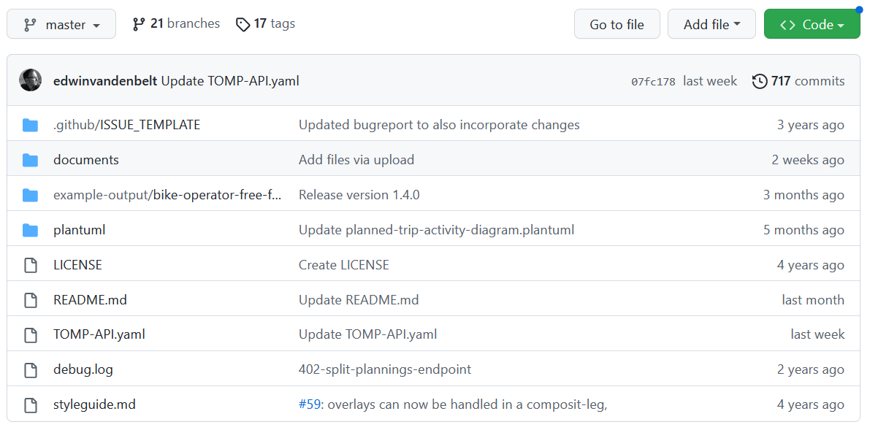
TOMP-API Presentation
TOMP-API allows to inquire prices, confirm availability of offers and to book
TO–MP API = Transport Operator to MaaS Provider API
Github repository (https://github.com/TOMP-WG/TOMP-API )
TOMP-API.yaml : Swagger defining the API
UML (plantuml) : diagrams of sequences
Many documents (not always recent), including summaries of the working group
Some examples (4)
Note: les versions sont développées dans des branches dédiées et identifiée par des tag

Slide 6
TOMP-API Presentation
API
Open-API 3.0 (https://swagger.io/specification )
Programming Interface Description Standard (HTTP REST)
Swagger (or « specification OpenAPI ») in YAML format (and not JSON) - authorises comments (not much used in the end)
Actual Version 1.4 of TOMP API (used for this analysis)
This is the heart of the technical implementation of TOMP-API
Online visualization tool https://app.swaggerhub.com/apis/TOMP-API-WG/transport-operator_maas_provider_api/1.4.0

Slide 7
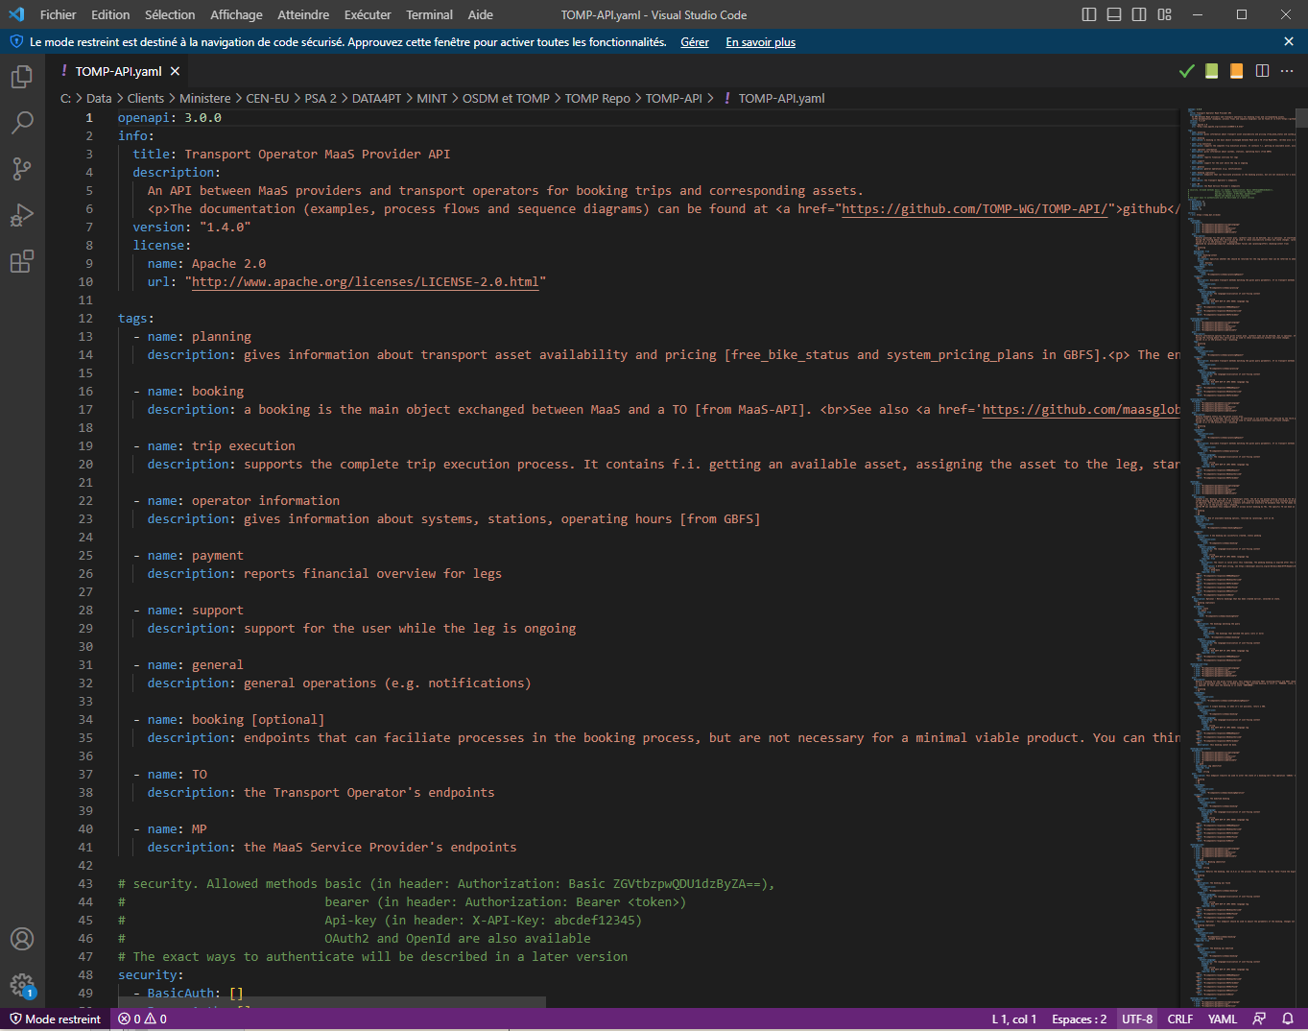
TOMP-API Presentation
Code YAML

Slide 8
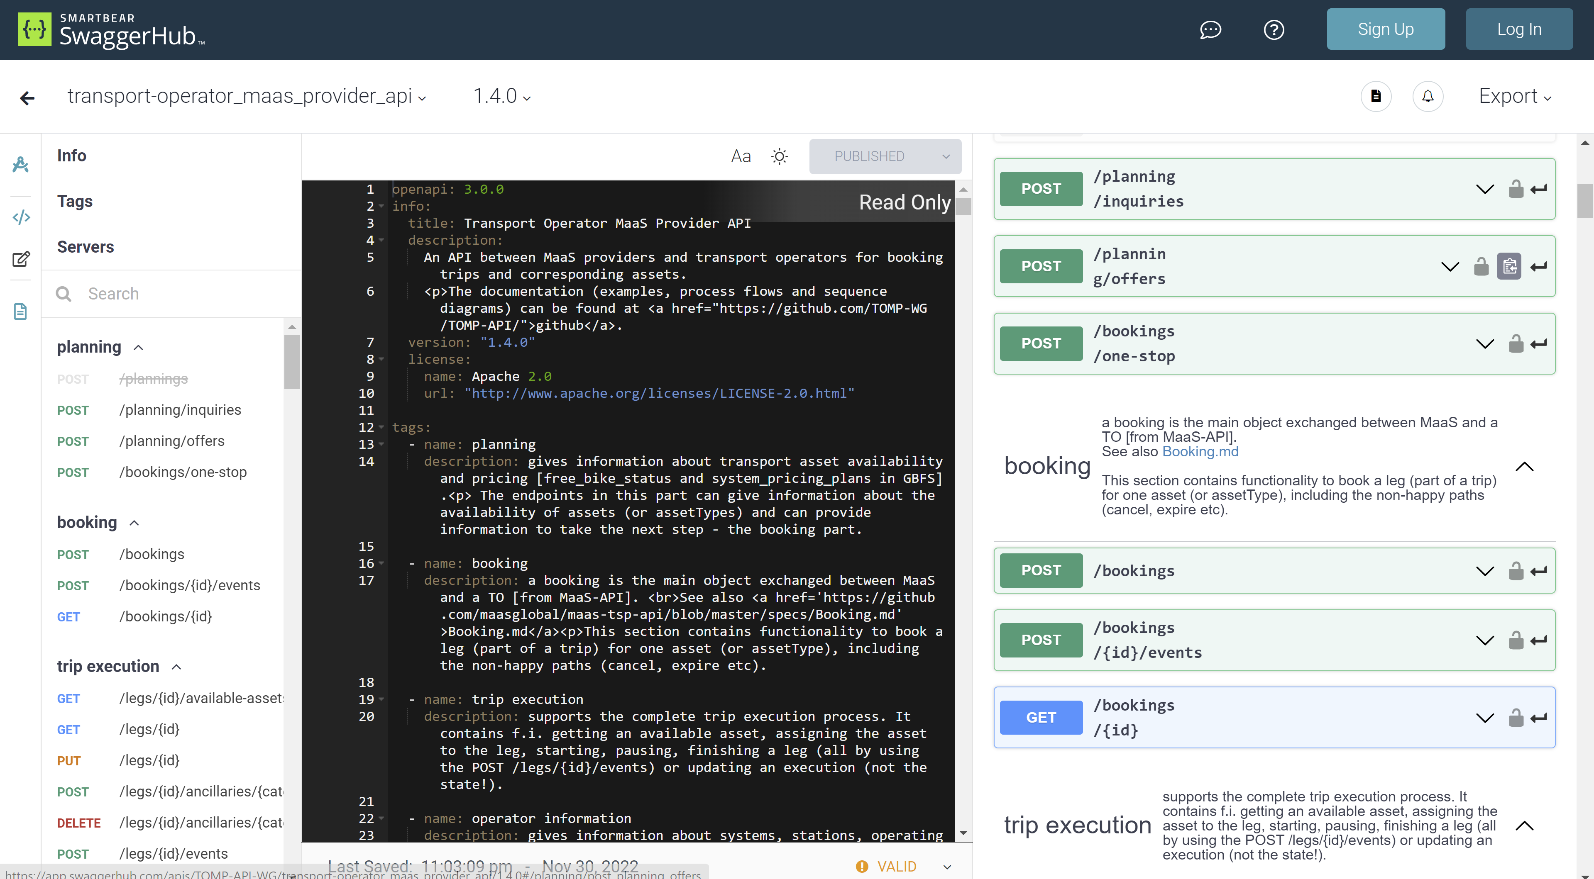
TOMP-API Presentation
Visualisation on app.swaggerhub.com

Slide 9
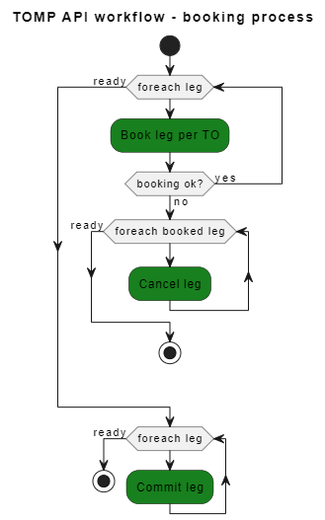
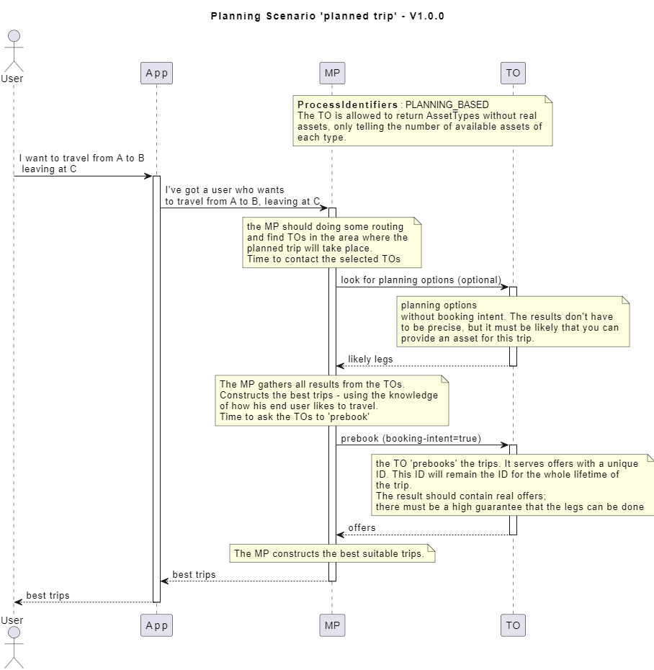
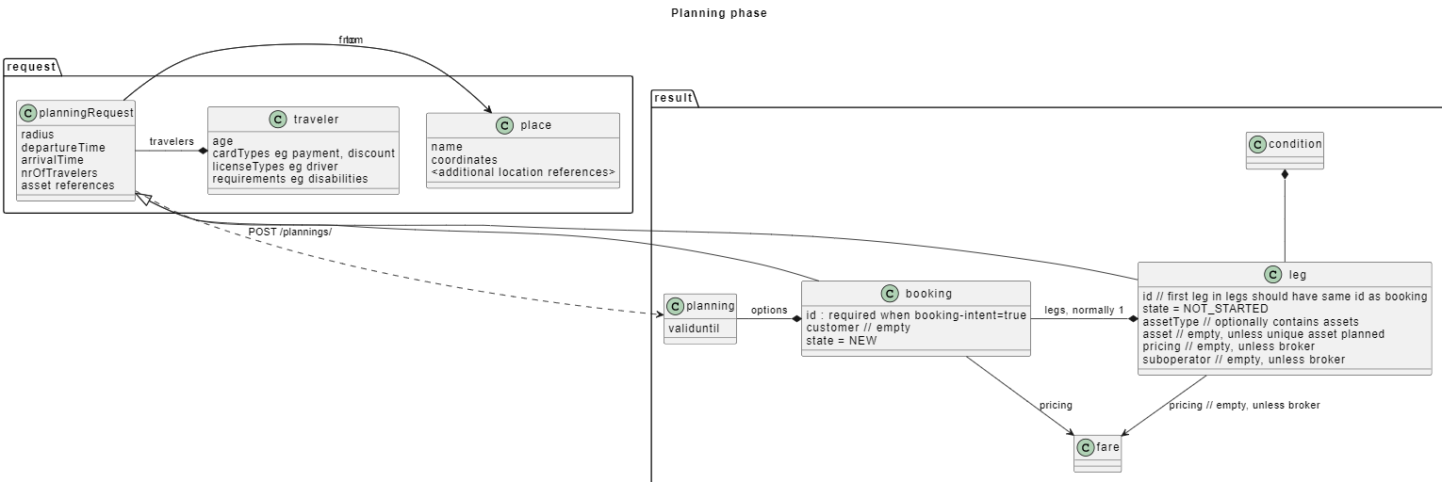
TOMP-API Presntation
Interaction diagram PlantUML
It is possible to define the action sequences for the selected use cases, and therefore the main TOMP API services
Doesn't seem to be regularly updated
Non compatible with CEN tools

Slide 10
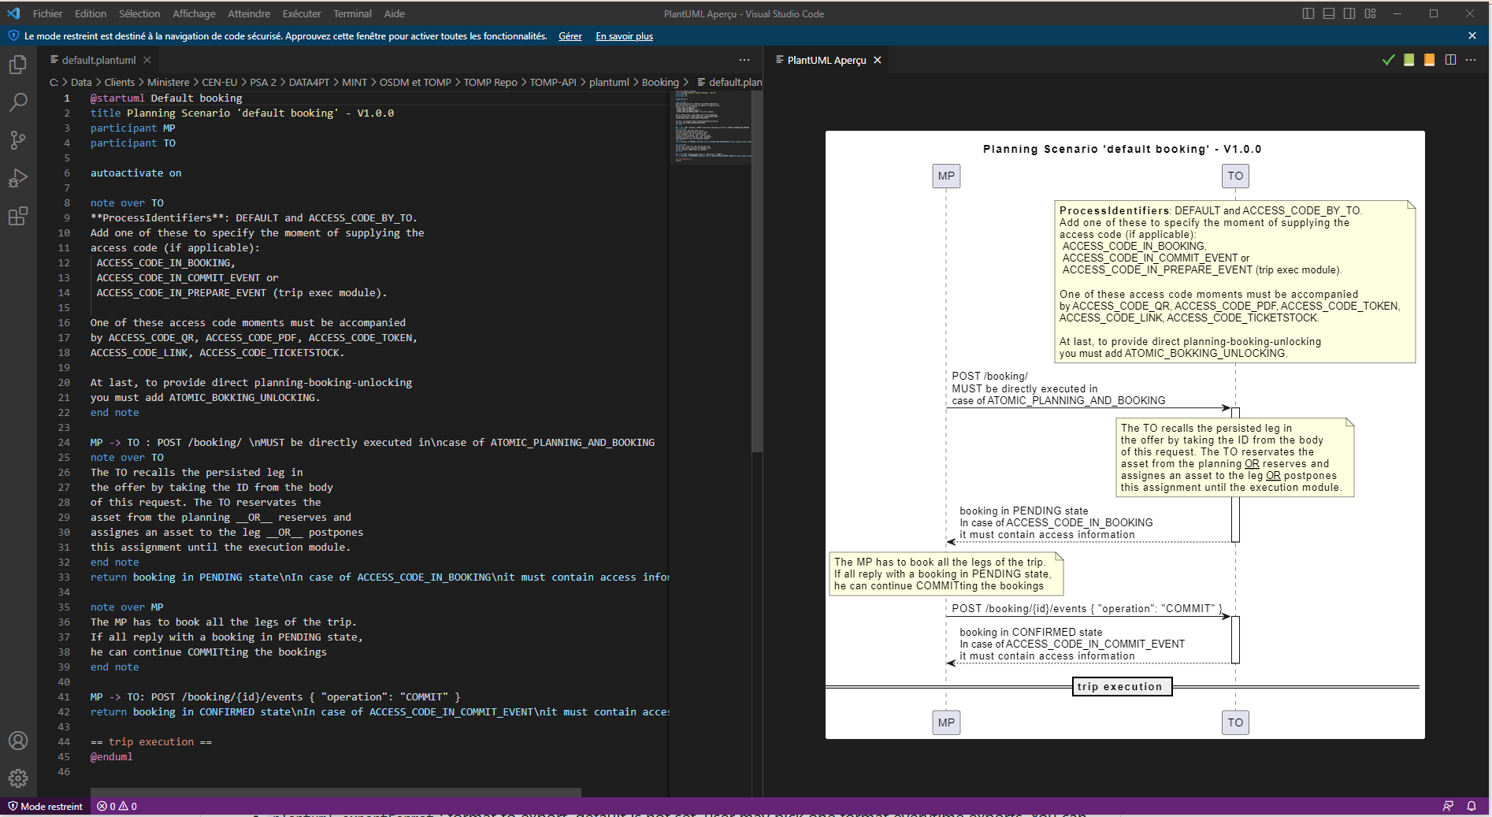
TOMP-API Presntation
Interaction diagramme PlantUML

Slide 11
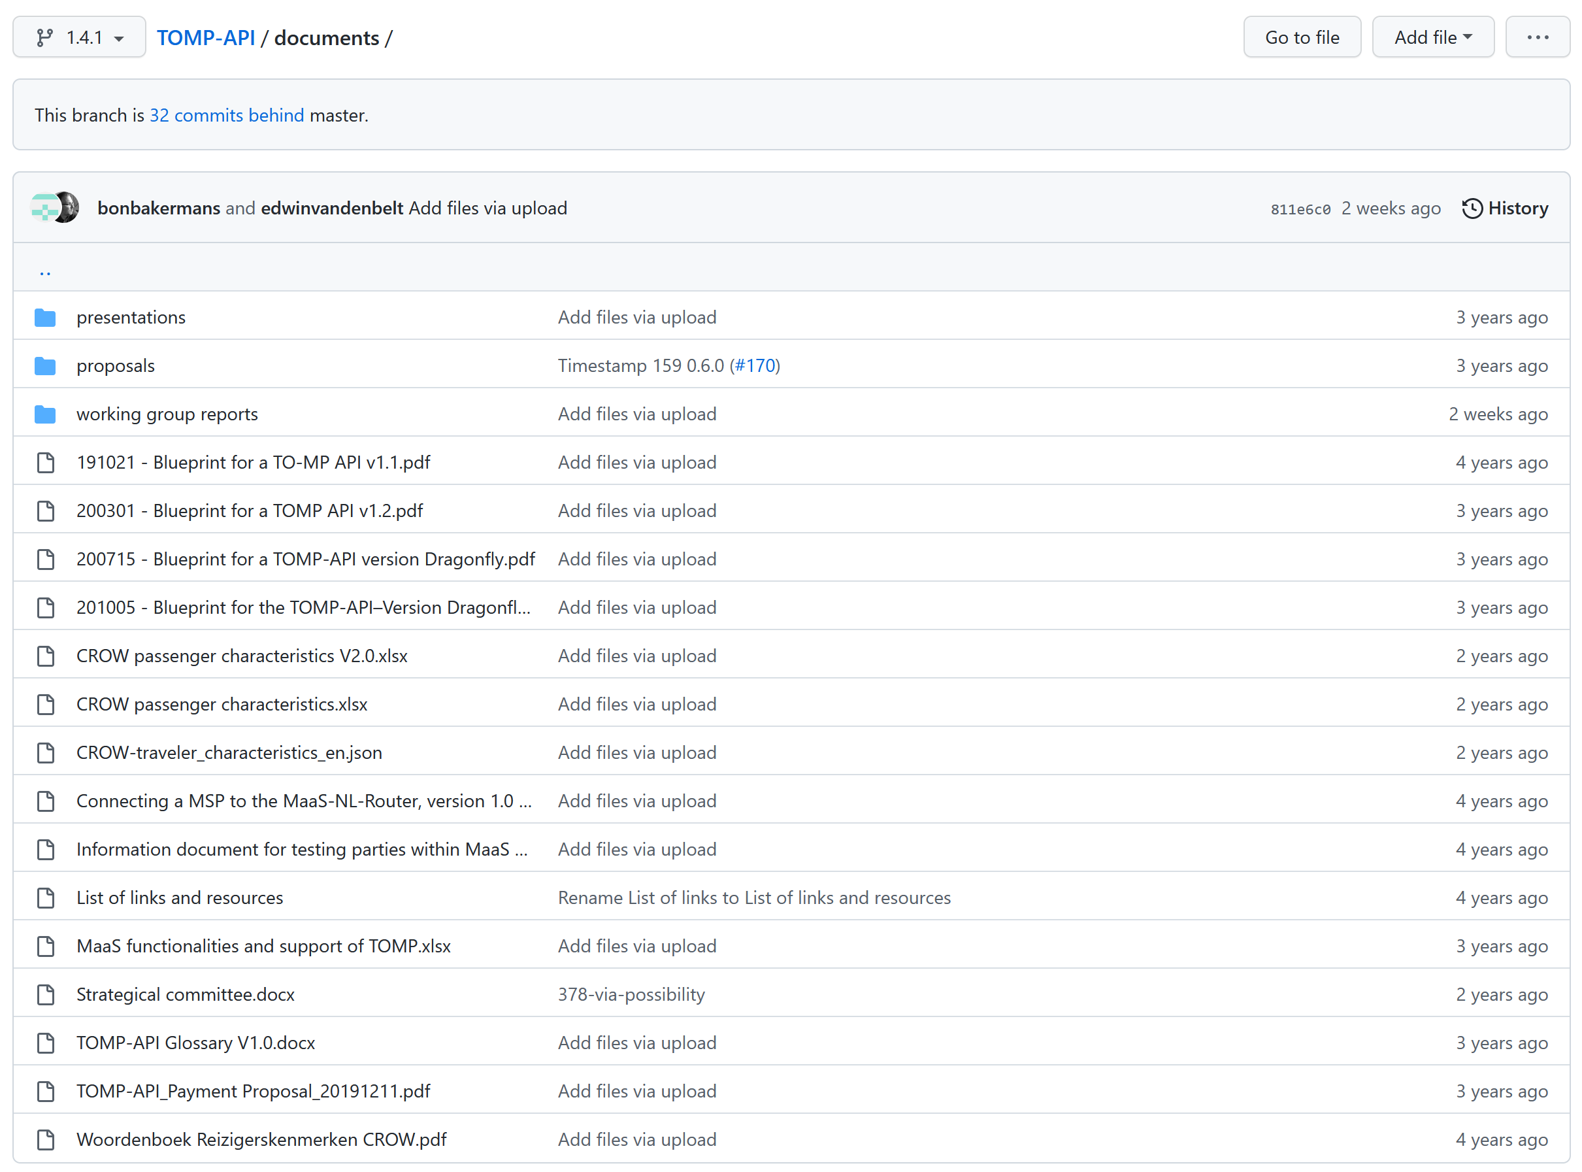
Documentation
Le YAML est « auto documenté »
But this is not enough to answer all the questions (API documentation, no model or interaction)
But this is not enough to answer all questions (API documentation, no model or interaction)
It also gives a very low level of vision which sometimes lacks a bit of hindsight.

Slide 12
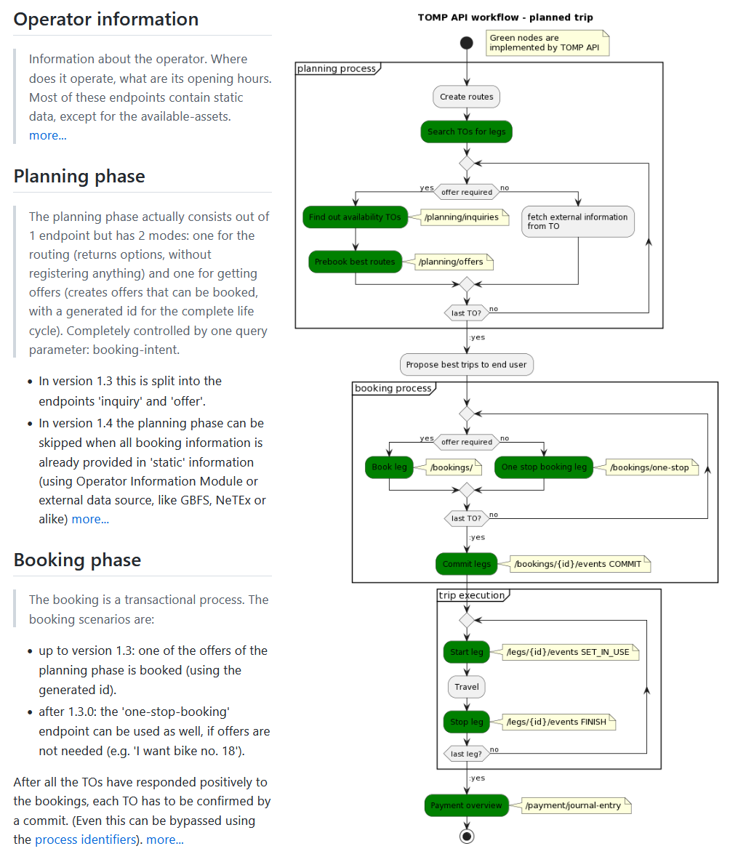
Documentation
https://github.com/TOMP-WG/TOMP-API/wiki

Slide 13
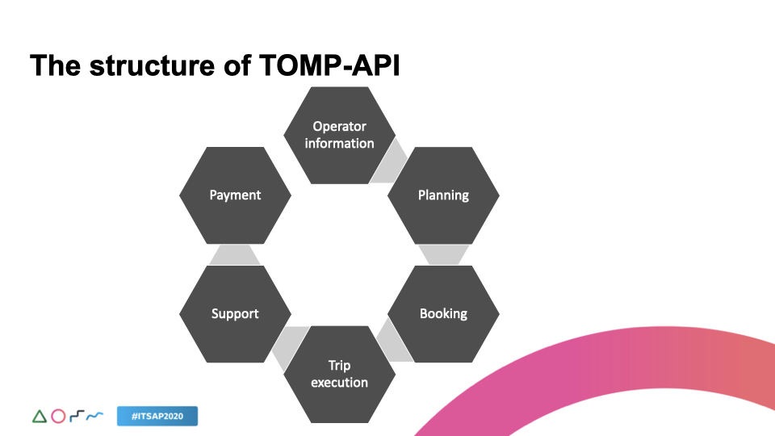
Services TOMP
Services
Source Skedo

Slide 14
Services TOMP
Operator Information
get (all) /operator/ping This is a healthcheck endpoint to see if the TO is up and running
/operator/meta Describes the running implementations
/operator/stations Describes all available stations => NeTEx
/operator/available-assets Returns a list of available assets (note: peu clair pour transport public) => NeTEx
/operator/alerts informs customers about changes outside of normal operations => SIRI
/operator/operating-calendar describes the operating calendar for a system (issu de GBFS) => NeTEx
/operator/operating-hours describes the system hours of operation (issu de GBFS) => NeTEx
/operator/information Describes the system (operator, location, URLs, contact info…) => NeTEx
/operator/pricing-plans Describes pricing of systems or assets [from GBFS] => NeTEx
/operator/regions describes regions for a system that is broken up by region => NeTEx
Note: NeTEx scope
Planning
post /planning/inquiries
Returns informative options for the given travel plan (for O/D)
post /planning/offers
Returns bookable offers for the given travel plan.
Note: OJP scope
post /bookings/one-stop
Returns bookable offers for the given travel plan.
Booking
post /bookings
post /bookings/{id}/events
get /bookings/{id}
Optional:
get/bookings Returns bookings that has been created earlier
put/bookings/{id} Adjust the parameters of the booking
post/bookings/{id}/subscription Subscribe to a specific booking (=leg & (type of) asset).
delete/bookings/{id}/subscription Delete subscription

Slide 15
Les Services TOMP
Trip Execution
get /legs/{id}/available-assets Returns a list of available assets for the given leg (Ticket ou course..?)
get /legs/{id} Retrieves the latest summary of the leg => OJP
put /legs/{id} Updates the leg with new information (from TO…)
post /legs/{id}/ancillaries/{category}/{number} A new ancillary is added to the leg. => NeTEx/SIRI (ancillary=equipement?)
delete /legs/{id}/ancillaries/{category}/{number} An ancillary (or amount) is removed to the leg. => SIRI
post/legs/{id}/events Alter the state of a leg (ASSIGN_ASSET, TIME_POSTPONE, FINISH, etc.)
get/legs/{id}/progress Monitors the current location of the asset and duration & distance of the leg (TO)
post/legs/{id}/progress Monitors the current location of the asset and duration & distance of the leg (MP)
post/legs/{id}/confirmation The TO can request confirmation for certain actions from the MP. ({id}=leg)
Note: SIRI scope
Support
post/support/ Creates a request for support from end user via MP
get/support/{id}/status Gets the status report of the support request.
Payment
get/payment/journal-entry Returns all the journal entries that should be paid per leg
post/payment/{id}/claim-extra-costs Extra costs that the TO has to charge to the MP or vice versa. (?? not to user ??)

Slide 16
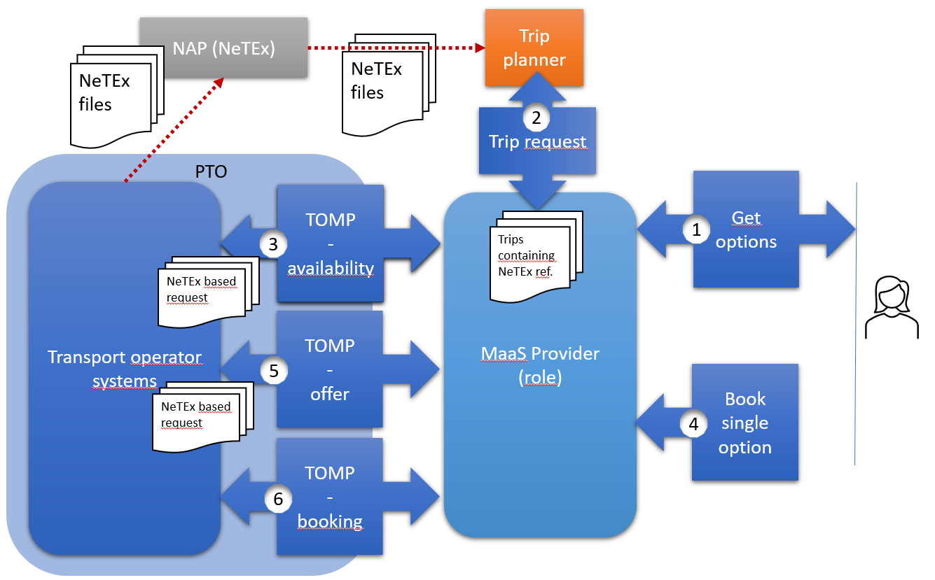
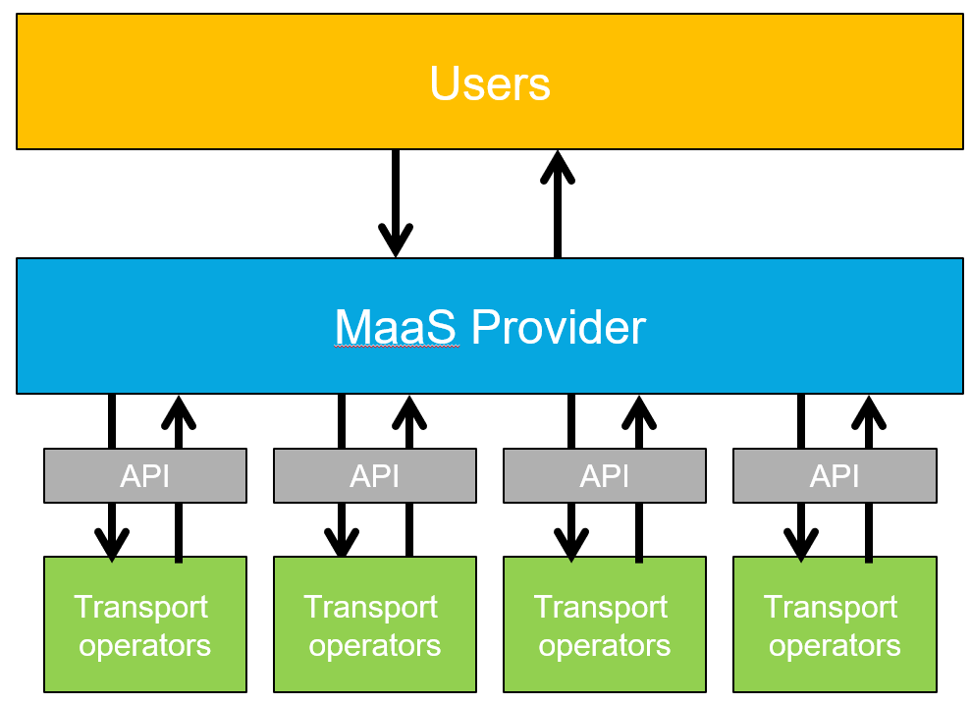
System architecture
A relatively simplified overall architecture (view with possible integration of NeTEx)
Source https://www.linkedin.com/pulse/best-both-netex-tomp-api-edwin-van-den-belt/

Slide 17
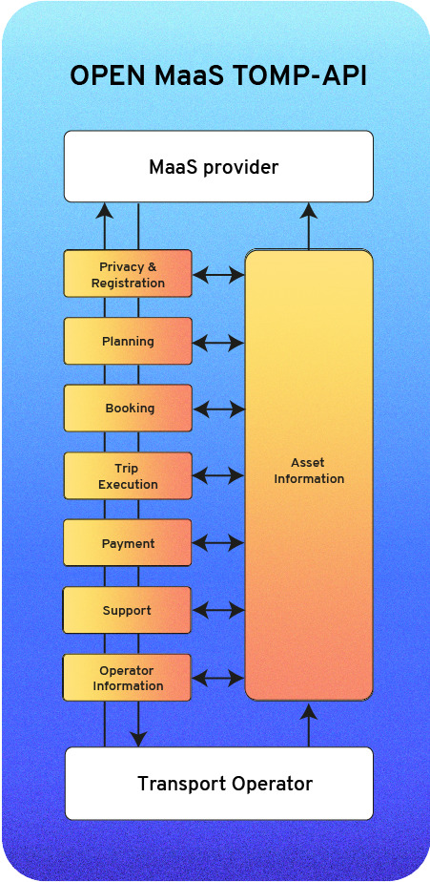





Architecture
A structure completely built on the route sections(leg)
Bus
Tram
Marche
Marche
« Booking » of an « asset » per « leg »
Very generic notions to bring a certain agnosticism
Walking and connections will not lead to booking …
It does not cover the use cases like:
How to manage the case where one ticket is for Bus/Tram and one ticket for Métro
Round trip
User's profile (social ticket, family ticket, etc.)
Subscriptions
Touristic tickets (like weekly tickets for specific zone)
Métro

Slide 18
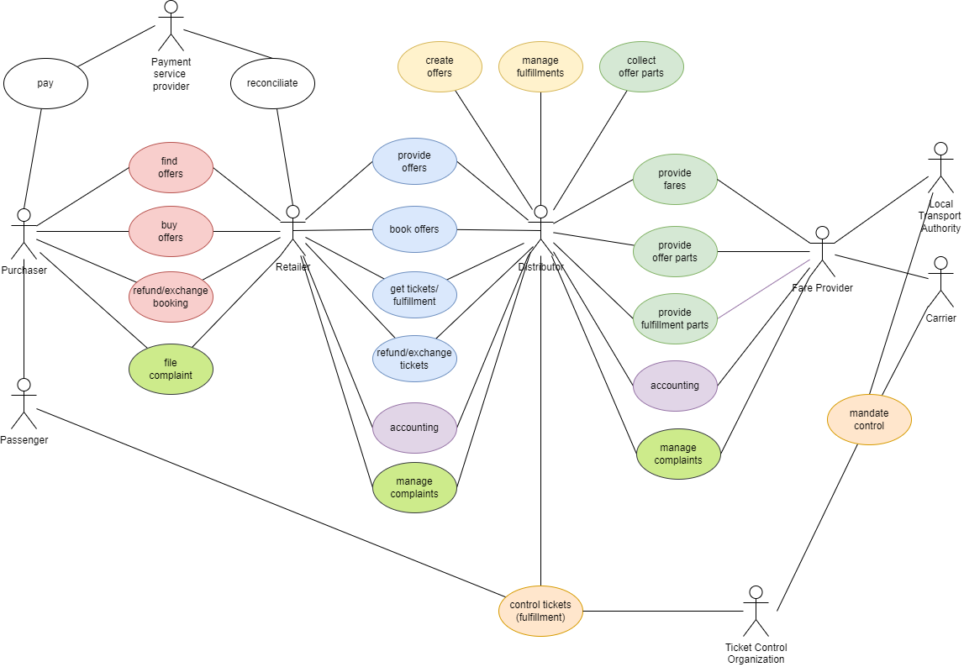
System architecture
Comparison - OSDM: roles and actors (for comparison)
Abonnements

Slide 19
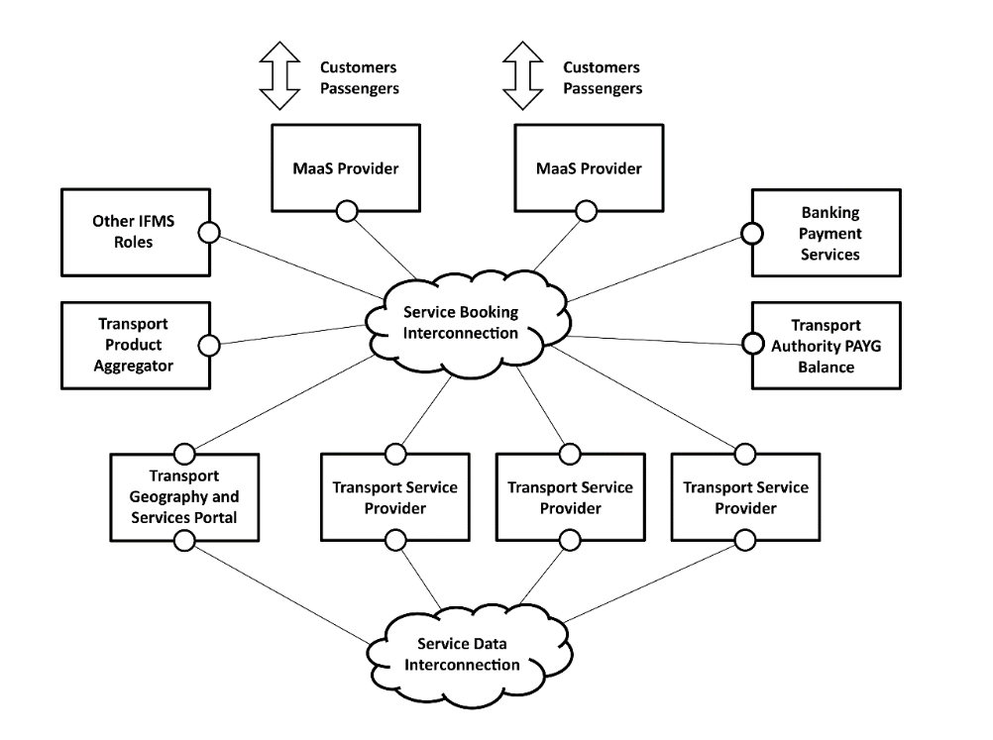
System architecture
Comparison - Transport distribution architecture – TR Distribution APIs of CEN/TC278 WG3 (for comparison)

Slide 20
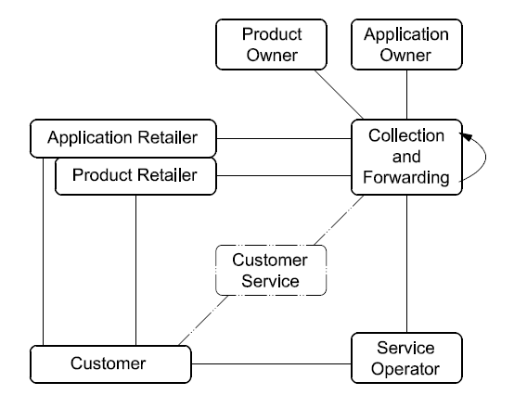
System architecture
Comparison – Roles in IFM

Slide 21
Relations with GBFS
GBFS (and bike sharing) is the main/initial use case TOMP-API was built for
The example on Github concerne bike sharing
The notion asset aims to be generic but remains quite linked with the vehicle to book
It is deeply inside the API (check next slide)

Slide 22
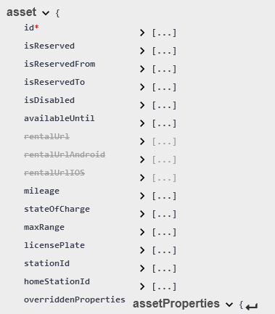
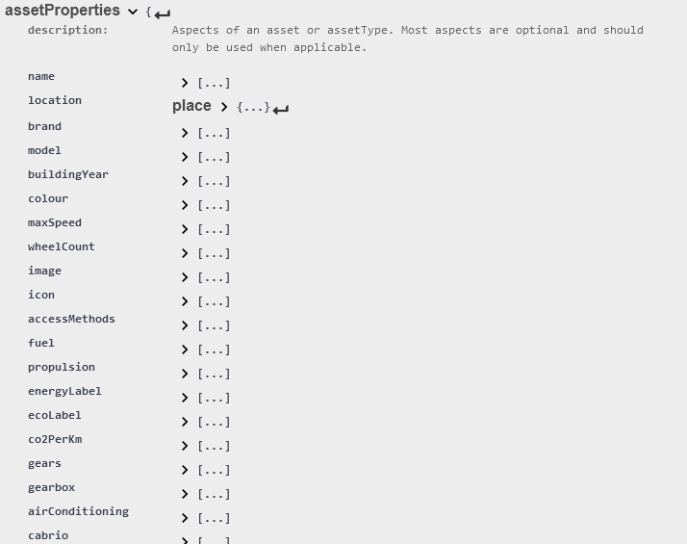
Relations with GBFS

Slide 23
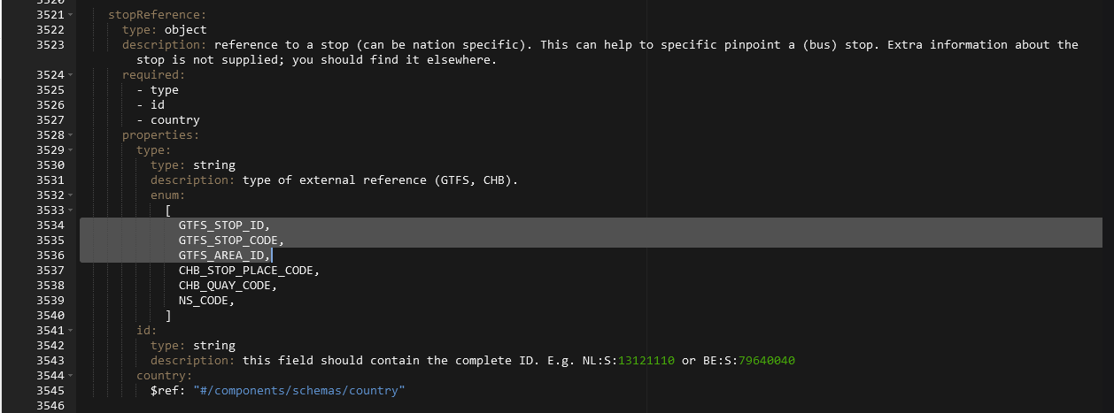
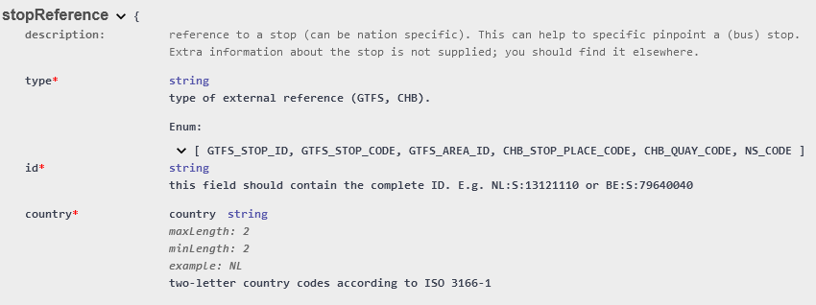
Relations with GTFS
The relations with planned data of public transport have been considered
We find them in Swagger (especially for the identification of stops )
Note the absence of NeTEx and the explicit reference to the Dutch national stop reference

Slide 24
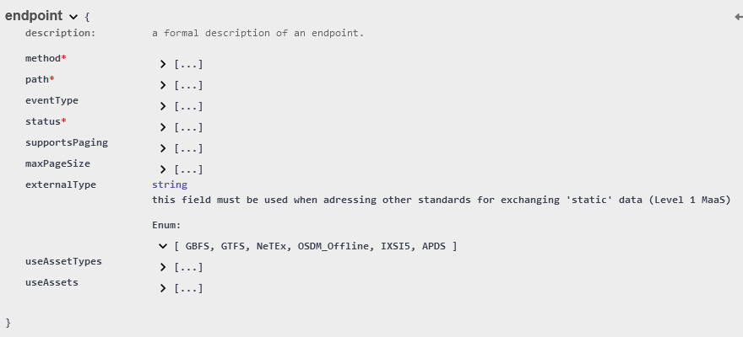
Relations with GTFS
Found in Swagger (especially for identification of stops)

Slide 25
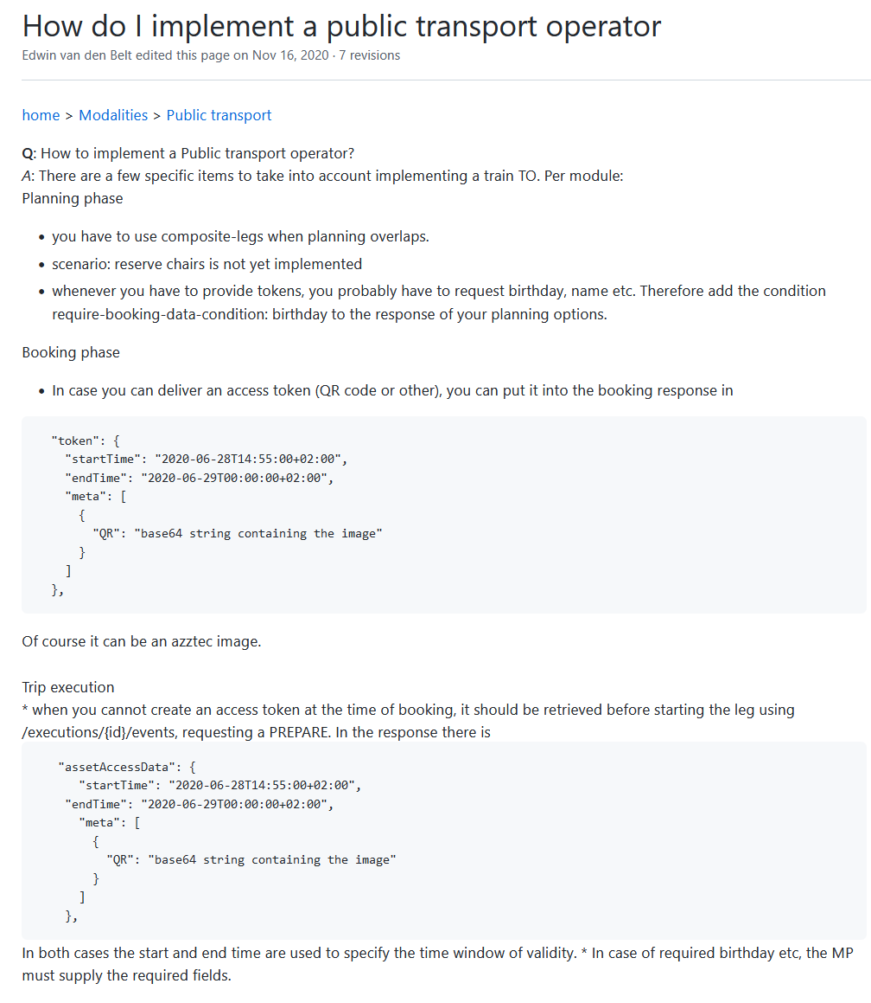
TOMP and the "classic" public trasport
https://github.com/TOMP-WG/TOMP-API/wiki/How-do-I-implement-a-public-transport-operator
Identical scenario for Bus, Metro, Train…​
But no “composite-leg” currently in the YAML
And this means that the journey planner must do the pre-division to be consistent with the tarification (example of a Bus+Tram+Metro trip in Paris) The reservation seems to refer to the transporter's services

Slide 26
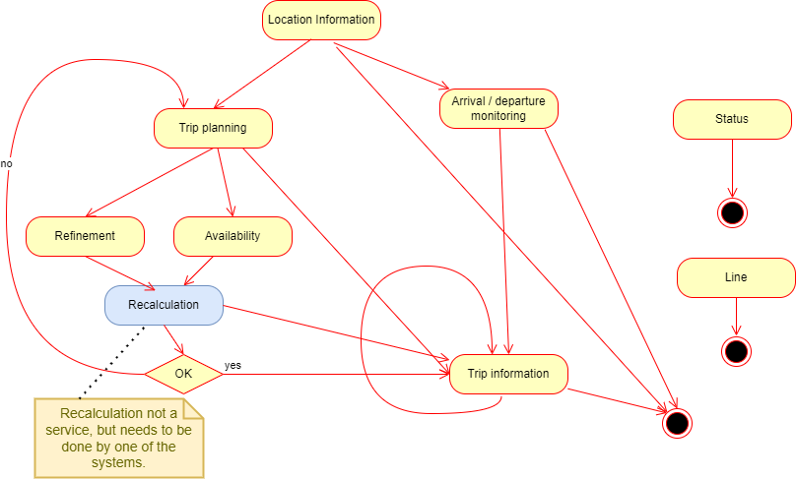
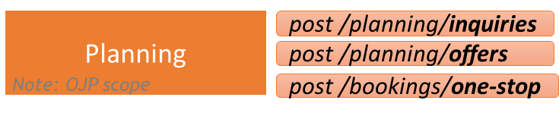
Position comparing with OJP
OJP covers (much) more than the Planning service of TOMP
OJP Services and utilisation sequence

Slide 27
Position comparing with OJP
OJP covers (much) more than the Planning service of TOMP
OJP Services and utilisation sequence
Note: OJP makes several references to TOMP and consistency with TOMP has been taken into account
Location information | matching text input against possible origin and destination locations
Exchange points | Connexion point for Distributed journey planning
Trip request | intermodal trip information from an origin location to a destination taking various user preferences into account
Distributed journey planning | Distributed journey planning
Departure/arrival board | provides information on arrivals and/or departures of public transport services from stops for a requested time or period of time
Trip/Vehicle information | information on a single trip (service pattern, real-time status, vehicle facilities etc .).
Ticket price calculation | general, stop-specific and trip-specific fare information
Availability information | informs about the availability of a MOBILITY SERVICE, a VEHICLE, SERVICE JOURNEY, or SINGLE JOURNEY
Line information | informs about about a specific line
Refinement of trips | additional or updated information about a known, previously retrieved trip

Slide 28
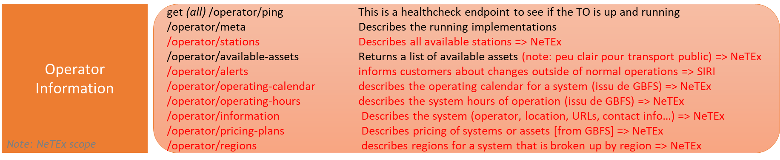
Position comparing with NeTEx
NeTEx covers all the "Operator Information" part and much more ​ - For all the modes considered… and more
Only identifiers are exchanged (exchangeable)​ This ensures agnosticism … in a limited way​
It has many TOMP element that​ could advantageously reuse Transmodel Model and Implementation​ NeTEx​ Leg, Operator, Address, Place, Stop Place, ​ Day & Day Types, etc. etc.​ The concept of FARE PRODUCT (tariff product)
would have been useful!​

Slide 29
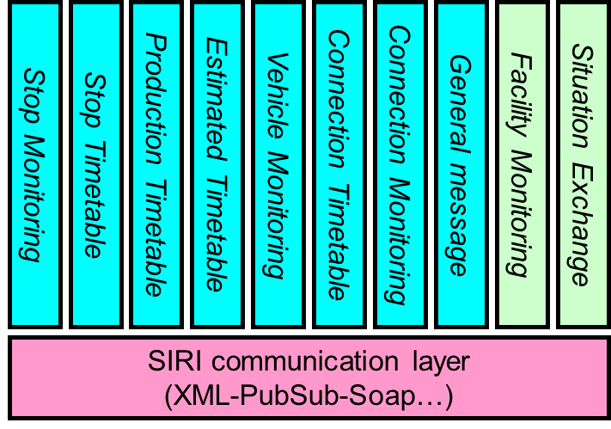
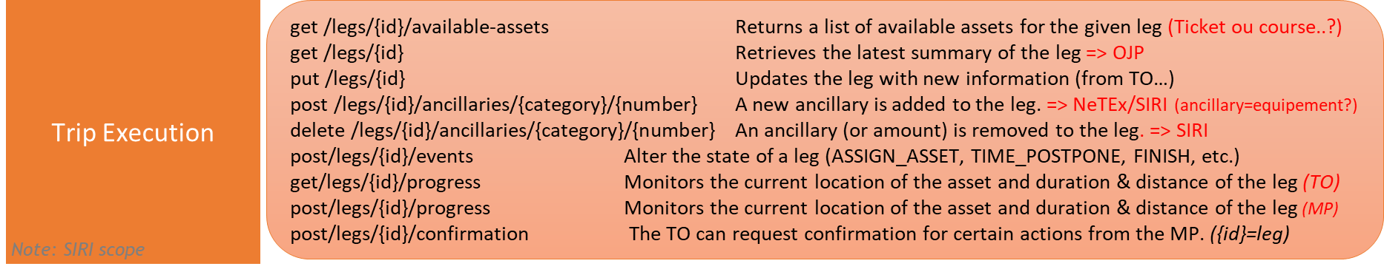
Position comparing with SIRI
SIRI Covers all of TOMP's Trip Execution needs (and much more) ​ The main difference is the fact that TOMP focuses on "Legs" and SIRI on trips If NeTEx appears in a certain number ​of presentations and documents related to TOMP, ​ SIRI has been largely forgotten Also note that SIRI has set up a ​ “Communication Layer” shared with ​ OJP and NeTEx, and which could have been ​ reused

Slide 30
Replying to key questions
Can TOMP-API be used for new mobility modes but also for public transport and the planning of multimodal journeys?
TOMP does not provide the planning itself (it is an interface relay)
OJP is much more complete
The reservation part (booking) is suitable but only for some particular use case… starting from a route search and with routes where each section can lead to the reservation of an independent “asset”

Slide 31
Replying to key questions
TOMP-API can be used for: "planning ", booking, purchasing, payment...?
The focal point is really the reservation
Purchase and payment are not supported
Planning remains simple (and relevant to target modes), but OJP is more comprehensive

Slide 32
Replying to key questions
What is the link between the "planning", as prevented by TOMP-API, and the theoritical info included in TC278/WG3/SG9 and the service included in TC278/WG3/SG8 ?
Utilise NeTEx (TC278/WG3/SG9)
Not covered
Utilise OJP (TC278/WG3/SG8)
Interesting to work on
Utilise SIRI (TC278/WG3/SG7)
And OJP for the visualisation per trip segment(Leg)

Slide 33
Replying to key questions
TOMP-API, supposed to be standards-agnostic, can it ensure interoperability between:
data (traveller info) provided in a CEN NeTEx format and other data related to planning, booking and/or purchasing a transport or mobility service?
data related to the CEN OJP standard and other data related to the reservation and/or purchase of a transport or mobility service?
In a very limited way (covers only a very small subset of the functional scope)

Slide 34
Replying to key questions
At which level TOMP-API can hadle dynamic data with regard to SIRI services?
Very partially
With a view by route section or by equipment
The view by trip segment can be provided by OJP

Slide 35
Conclusion
A good protocol but with relatively limited use cases
The itinerary structure with the “Booking” of an “asset” by “leg” only covers part of the needs
But offers a first option for booking management
It cannot be replaced in any way or offer an access interface to OJP, NeTEx and SIRI
The evolution to fully take into account the Transmodel ecosystem would lead to many "acrobatics" and will be tricky because of the fairly deep interweaving of bike sharing in the API
The payment still remains uncovered

Slide 36
Other projects to have in mind
OSDM
https://osdm.io/spec/getting-started
Projet COROM (CEN)
Projet CEN financé par la Commission
Commission Européenne, DGMOV => MMTIS/MDMS
MMTIS – Règlement Délégué (UE) 2017/1926 Révision en cours
MDMS Multimodal Digital Mobility Services MDMS means a service provide ng information on traffic and travel data such as location of transport facilities, schedules, availability or fares for more than one transport mode, which may include features enabling the making of reservations, bookings or payments or the issuing of tickets.

Slide 37
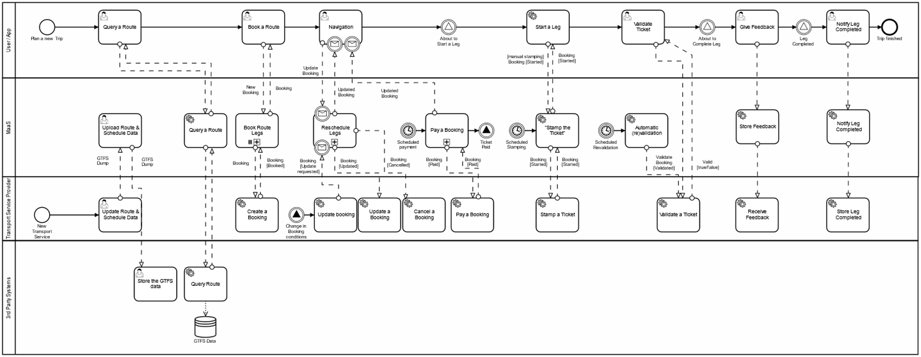
Other projects to have in mind
Whim API (source GitHub maasglobal/maas-tsp-api référencé par le Swagger TOMP) Voir aussi https://maasglobal.github.io/maas-tsp-api/redoc.html#section/Updating-a-booking

Slide 38
Other projects to have in mind
BoB (Samtrafiken) https://samtrafiken.atlassian.net/wiki/spaces/BOB/overview
SKI+ (Suisse) https://transportdatamanagement.ch/de/standards/#standards-SKI+ https://transportdatamanagement.ch//content/uploads/2023/01/TOMP-API-SKIProfil-0.5.pdf https://github.com/openTdataCH/ojpch/tree/main/doc/ojpfare2tomp_analysis
Oslo (Belgium) https://www.its.be/maas/technical-harmonisation/oslo
eHub - eHUBS - Smart Shared Green Mobility Hubs (Interreg) – TOMP Based https://www.nweurope.eu/media/12785/d63_api_standard_for_information.pdf
MaaS Global (Finland) https://whimapp.com/about-us/ https://github.com/maasglobal/

Slide 39
Other projects to have in mind
Kasia Bourée et Edwin van den Belt https://www.linkedin.com/pulse/best-both-netex-tomp-api-edwin-van-den-belt/
Matthias Guenter https://transportdatamanagement.ch/fr/standards/
Skedo https://skedgo.com/introducing-the-tomp-api/
TOMP WG
MaaS Alliance
OJP
OSDM
CEN

Slide 40
Merci de votre attention

